Slide 1


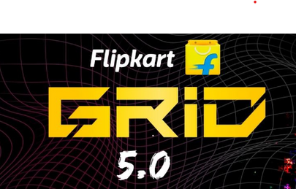





Personalized Product Recommendation
TEAM : 686157-UHS03Z07

Slide 2
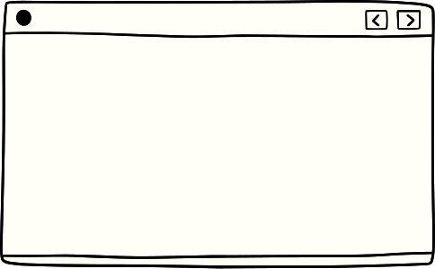



Team members details
Team Name : 686157-UHS03Z07
Institute Name: MVGR College of Engineering
TEAM MEMBER 1 (Leader)
TEAM MEMBER 2
NAME:
NAME:
Nistala
Tejaswi Karthik
Kurella
Amar Sai Preetam
Batch : 2024
Batch : 2024

Slide 3

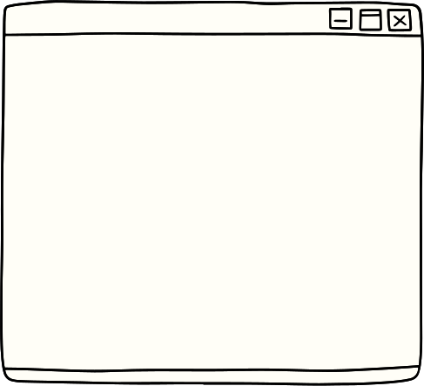



Deliverables / Expectations
To create a hybrid recommendation system by:
Integrating collaborative filtering (SVD) and neural networks for accurate predictions.
Considering user's browsing history and product lifespan for relevance.
Generating recommendations based on recent interactions and model predictions.
Combining collaborative and neural recommendations for enhanced suggestions.
Enabling customization for diverse domains like e-commerce, streaming, and more.

Slide 4
Collaborative filtering: A technique that can filter out items that a user might like on the basis of reactions by similar users
Glossary
Neural Network: A method in artificial intelligence that teaches computers to process data in a way that is inspired by the human brain.
SVD (Singular value decomposition): A method of representing a matrix as a series of linear approximations that expose the underlying meaning-structure of the matrix.
Collaborative filtering
Neural Network
SVD
Surprise
Cold Start Problem
Product Lifespan
Surprise: A Python scikit for building and analyzing recommender systems that deal with explicit rating data
Cold Start Problem : It refers to when items added to the catalogue have either none or very little interactions
Product Life span: The time interval from when a product is sold to when it is discarded.

Slide 5





E-Commerce Platforms (P0):
Recommending products to online shoppers based on their browsing history, past purchases, and the lifespan of products, thus enhancing the shopping experience and increasing sales.
Streaming Services (P1):
Suggesting movies or TV shows to users based on their viewing history, genre preferences, and the availability of content within a certain timeframe.
Use Cases
Social Media Platforms (P2):
Offering personalized friend or connection suggestions to users based on their social interactions, interests, and the recency of user activity.
Retail and Fashion Industry (P3):
Recommending fashion items or accessories to users based on their style preferences, purchase history, and the lifecycle of fashion trends.

Slide 6


Approaches
Collaborative Filtering (Surprise/SVD):
We use the Surprise library's SVD (Singular Value Decomposition) algorithm for collaborative filtering. Collaborative filtering is based on the idea that users who agreed in the past tend to agree again in the future.
Neural Network for Collaborative Filtering:
We use a neural network model to perform collaborative filtering based on user-item interactions. The neural network takes user and product IDs as inputs, embeds them, and combines their embeddings using a dense layer to predict ratings.
Solution Statement
Increasing effectiveness of the recommendation system using collaborative and neural networks approaches and models
Collaborative filtering
}
+
Combining Recomendations
Combining Recommendations:
For each user, we generate recommendations separately using both collaborative filtering (SVD) and the neural network model. We combine the recommendations from both models to provide a hybrid recommendation list that may capture different aspects of user preferences.
Neural Network

Slide 7





Limitations
Less Dimensions
Cold Start Problem
No Real-time Updates
The dataset used for training and testing is small and simplistic, which may not accurately represent the complexities of real-world user behavior and preferences . Influential attributes may differ in final recommendation.
The code does not address the "cold start" problem for new users or new products, where there may be insufficient data to make accurate recommendations.
The code does not include mechanisms for real-time updates of user interactions or product information, which are important for maintaining up-to-date recommendations.

Slide 8








Future Scope
Advanced Neural Network Architectures:
Explore more advanced neural network architectures for collaborative filtering, such as deep learning models with multiple layers, attention mechanisms, and recurrent neural networks (RNNs).
Enhanced Feature Engineering:
Incorporate richer user and product features, such as user demographics, historical behavior, social interactions, and product attributes, to improve recommendation accuracy and personalization.
Next Step
01
Advanced Neural Network Architectures.
02
Enhanced Feature Engineering.
03
Use of Implicit Data.
Use of Implicit Data:
Utilize implicit user behavior data, such as clicks, views, and purchase frequency, in addition to explicit ratings, to capture user preferences more comprehensively
Real-time Updates:
Implement mechanisms for real-time data ingestion and model updates to keep recommendations up to date as user interactions and product information change.
Online A/B Testing:
04
Real-time Updates.

Slide 9

Conclusion
Incorporating collaborative filtering and neural networks, our personalized recommendation system crafts precise product suggestions.
By analyzing user-item interaction data and product attributes, we optimize user experience. The Surprise library's SVD model captures latent patterns in user preferences, while our neural network leverages embeddings for comprehensive insights.
Recent interactions and product traits guide tailored recommendations.
Combining collaborative and neural network approaches delivers accurate suggestions, enhancing user engagement and satisfaction. .

Slide 10
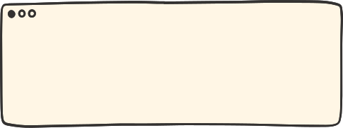
References
https://realpython.com/build-recommendation-engine-collaborative-filtering/
https://www.kdnuggets.com/2017/08/recommendation-system-algorithms-overview.html
http://sciplore.org/publications/2009Sc

Slide 11

Thank you
Team: 686157-UHS03Z07

